Slide 1











Government Engineering College,Naragund
Department of Collegiate and Technical Education
A Major Project Phase-II On
“HOME SECURITY SYSTEM USING ESP32-CAM”
Department of Artificial Intelligence and Data Science
Presented By: |  | Under the Guidance of Prof. ASHWINI S KALE
AMIT DHAVALESHWAR | 2NR22AD002
ANIL KUMAR R | 2NR22AD004 | Under the Co-Guidance of
HEMA CHALESARA | 2NR22AD009 | Prof. DEEPA MANAVACHARI
VISHNU R SHETTY | 2NR22AD039

Slide 2
ABSTRACT-
In recent times, the need for reliable security and protection systems has increased significantly across industrial, commercial, and residential environments. With rapid advancements in technology, modern security solutions can now be effectively implemented within homes to enhance safety and access control. This project presents a smart home security framework that integrates an intelligent face recognition system for authenticated entry. When an unknown person is detected or face verification fails, the system immediately sends an alert notification to the owner’s Telegram account, enabling quick awareness and response.
After successful recognition, the next stage of access control is handled manually by the homeowner. The owner uses a dedicated Arduino Bluetooth Control application, which communicates with a servo motor–based door lock mechanism. Through simple ON/OFF switch controls in the app, the homeowner can remotely open or close the door, ensuring an additional layer of manual verification and security. This hybrid system—combining automation with owner-controlled access—provides enhanced protection, flexibility, and user authority, making the home security solution both intelligent and trustworthy.

Slide 3

CONTENTS:
ABSTRACT
INTRODUCTION
PROBLEM STATEMENT
OBJECTIVES
LITERATURE SURVEY
BLOCK DIAGRAM
SYSTEM REQURIMENTS
IMPLEMENTATION
RESULTS
CONCLUSION
REFERENCES

Slide 4
INTRODUCTION:
In today’s world, ensuring home security has become a major concern due to
the rise in unauthorized intrusions and thefts. Traditional systems often depend on manual monitoring or expensive hardware, making them less efficient and inaccessible for many users. The proposed ESP32-CAM-based home security system offers a smart, affordable, and automated solution by combining camera surveillance, motion detection, and real-time alerts. Using IoT technology and image processing, it allows users to remotely monitor their homes from anywhere. This system not only enhances safety but also integrates convenience, reliability, and scalability making it an ideal choice for modern smart homes.

Slide 5
PROBLEM STATEMENT:
Conventional home security systems are either manually operated or
use limited automation, lacking intelligent monitoring and user verification. This often leads to false alarms, delayed responses, and security breaches. The proposed ESP32-CAM-based system provides real-time image capture, motion detection, and instant alerts to enhance security, accuracy, and user control in a cost-effective manner.

Slide 6
OBJECTIVES:
The Objectives are as follows…..
To develop a real-time home security system using the ESP32-CAM module that captures and transmits images of detected motion or face via Telegram.
To implement wireless communication and remote monitoring using IoT technology, allowing homeowners to access live alerts and images from anywhere.
To integrate AI/ML-based face detection for identifying authorized and unauthorized individuals, enhancing the security and intelligence of the system.
To automate door control using Arduino Uno and a servo motor, enabling the system to open or close the door only after user verification.
To minimize false alarms and enhance reliability through efficient image processing and secure cloud communication.
To create a cost-effective and user-friendly home security prototype that demonstrates the potential of IoT and AI integration for smart home safety.

Slide 7
LITERATURE SURVEY:
The Literature Survey is as follows:
Title | Year of published | Author(s) | Result | Link / Notes
IoT-Based Home Monitoring System Using ESP32-CAM Surveillance | 2021 | Pradeep Palkar, Prashant Bangar, Pranita Chandhare, Sahil Jadhav | Uses ESP32-CAM + motion detection to capture images and send alerts via Telegram bot; low-cost and no cloud storage required. (IJRASET) | View paper
Health Mirror Using ESP32-CAM | 2022 | Nikita D. Sane, Nikita S. Sawant, Priya R. Pal, Shreeraj S. Jain, Prof. Paurnima Vadak | IoT-based mirror measures temperature, oxygen, pulse, voice alerts, and image capture for health monitoring. (IJRASET) | View paper
Wi-Fi Pan Tilt Surveillance Camera Using ESP32 | 2023 | Adithya Umare, Harsh Ukey, Om Umale, Ujjwal Patil, Omkar Umbarje, et al. | Proposes a compact remotely- controlled movable camera using ESP32 for surveillance; easy setup. (IJRASET) | View paper
Smart Building Management System Using ESP32 | 2020 | G. Chandrashekar, P. Vaishnavi, D. Neeharika, N. Suchitha, T. Rohith | Integrates multiple sensors (PIR, LDR, IR, ultrasonic) with ESP32 and Thing Speak for automation & monitoring. | View paper
Design & Development of Smart Mirror Displaying Real- Time Sensor Data | 2019 | Preeti Rani, Indra Thanaya | Mirror displays personalized data (weather, time, sensor data) by integrating electronics & programming. (IJERT) | View paper

Slide 8

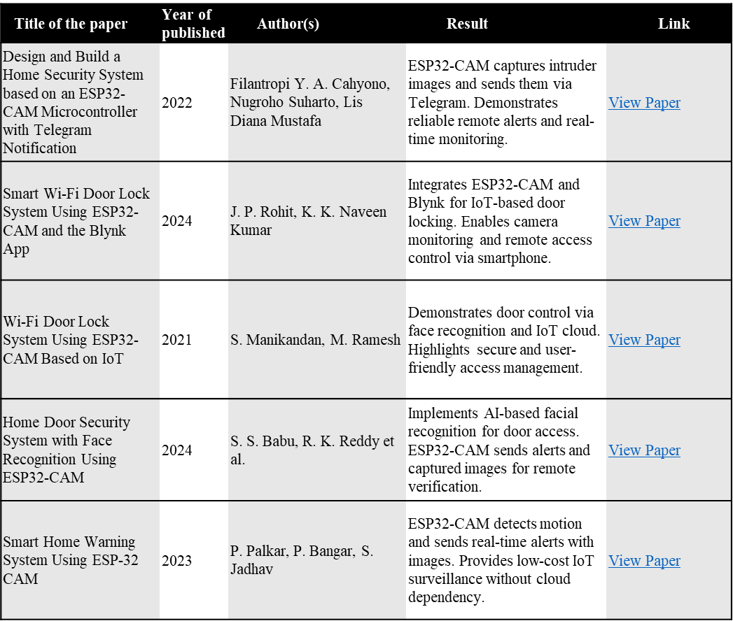
Continue…..

Slide 9
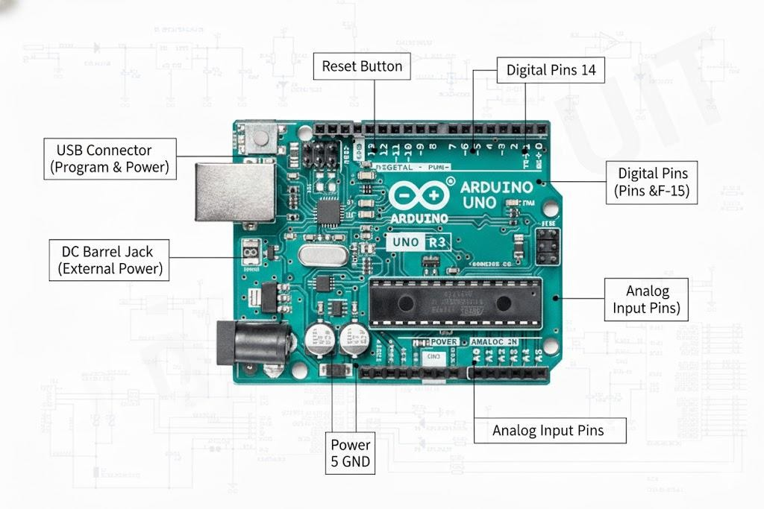
SYSTEM REQURIMENTS:
The Software Requirements are:
Micro Python libraries are as follows:
NumPy (np):NumPy is used for fast numerical operations and efficient handling of image data
arrays.
PIL (Image): PIL allows opening, converting, and manipulating images received from the camera stream.
Requests: The requests library fetches the latest image from the ESP32-CAM using an HTTP link.
Hardware Requirements:
Figure 01: ARDUINO UNO MODULE FRAMEWORK

Slide 10
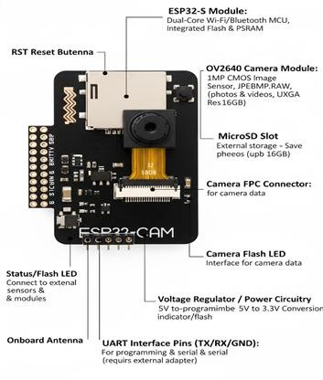
Continue of Hardware component:
Figure 02:ESP32 CAM Module

Slide 11
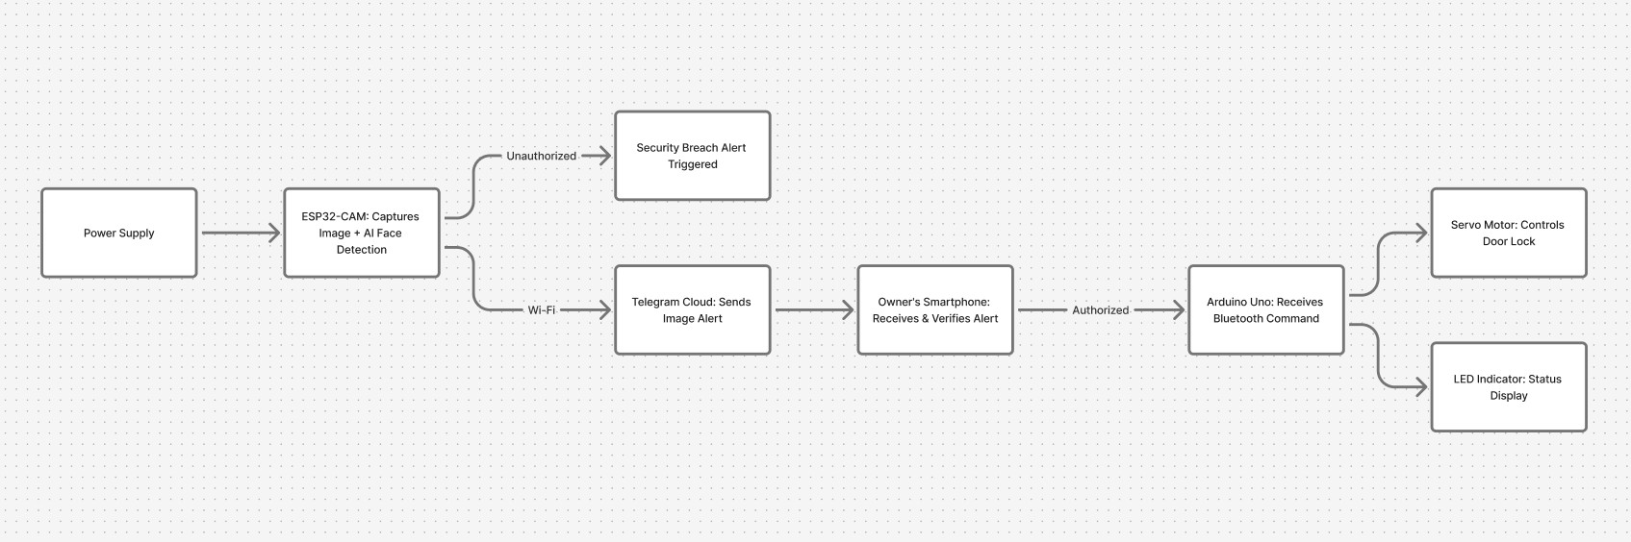
BLOCK DIAGRAM:
Figure 02: Block Diagram Of AI-Based Home Security Using ESP32-CAM and Arduino Uno

Slide 12
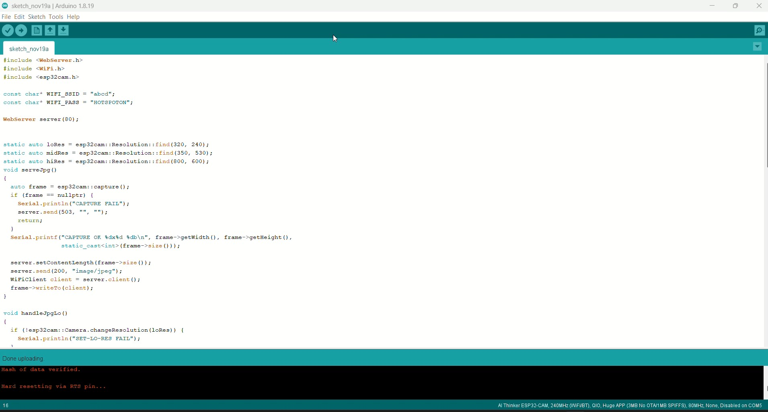
IMPLEMENTATION:
System Demonstration of ESP32-CAM Video Stream Integration and Real-Time Person Detection

Slide 13
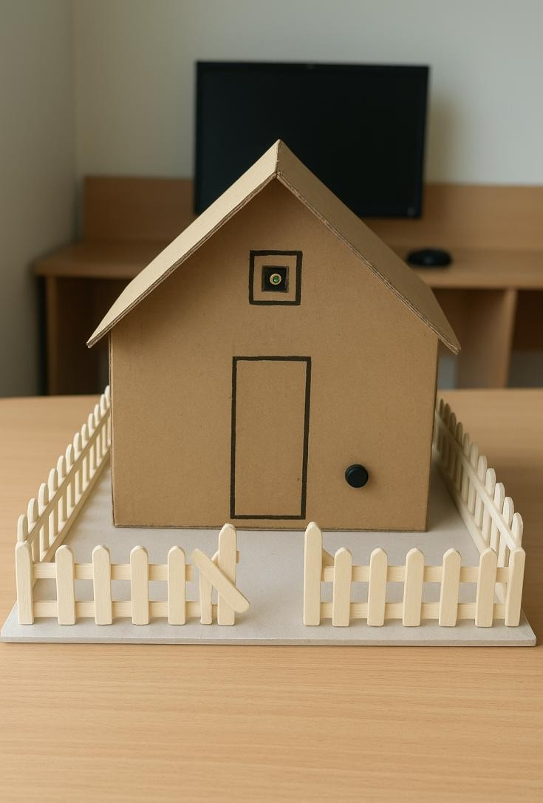
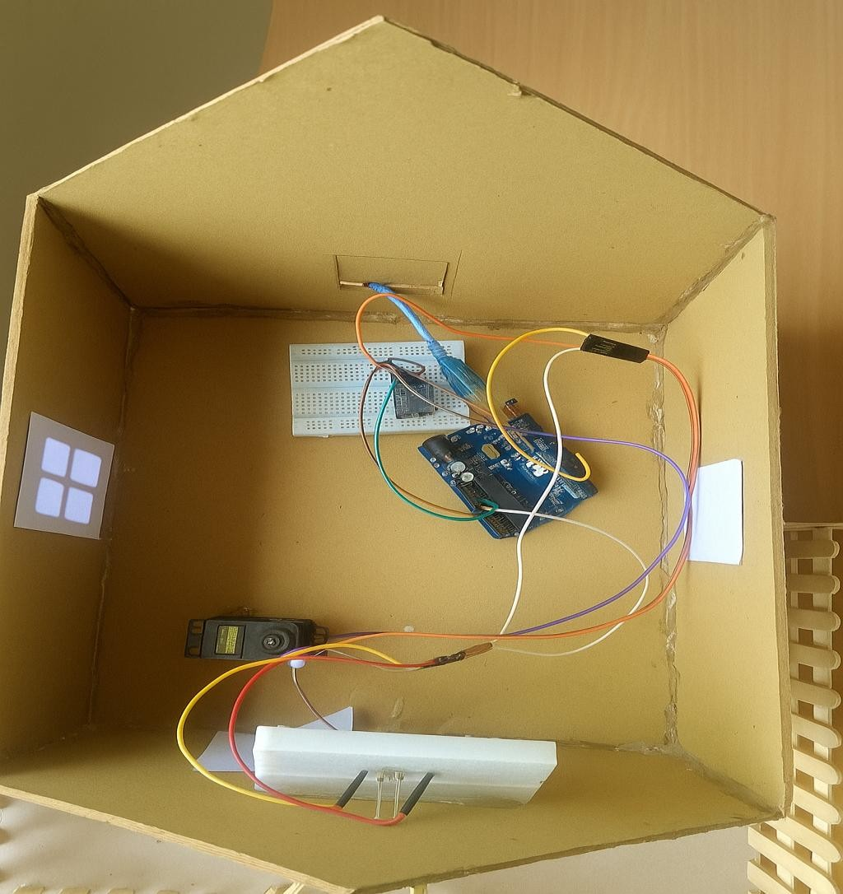
MODEL DEMONSTRATION
Figure 03:Prototype Model and Internal Circuit of ESP32-CAM Based Smart Home Security System

Slide 14
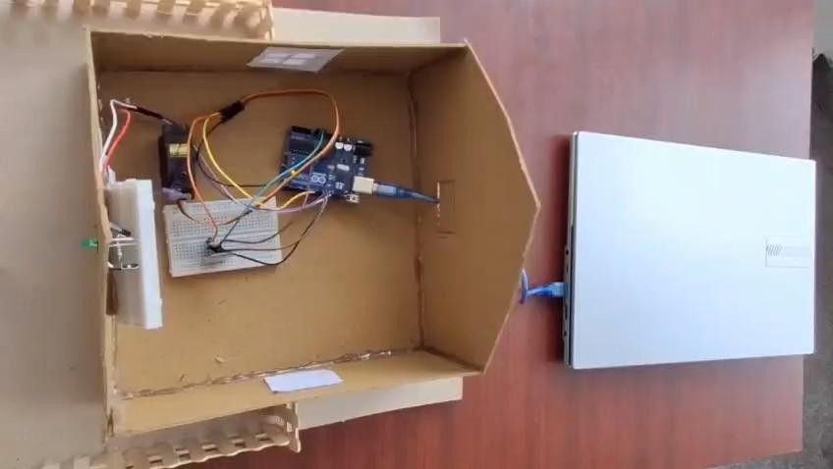
RESULTS:
Figure 04:Real-Time Person Detection Using Python on ESP32-CAM

Slide 15
CONCLUSION:
The proposed ESP32-CAM-based home security system provides a smart,
reliable, and cost-effective solution for modern residential safety. By integrating advanced image processing, motion detection, and real-time alerts, it ensures accurate intrusion detection and quick user response. The system’s remote monitoring capability through mobile devices enhances convenience and user control. Its low-cost design makes home security more accessible while maintaining high performance and reliability. Overall, this project successfully addresses the limitations of traditional systems and sets a new benchmark for intelligent, user-friendly home protection.

Slide 16
REFERENCES:
Design and Build a Home Security System Based on an ESP32-CAM Microcontroller with Telegram Notification
Filantropi Y. A. Cahyono, Nugroho Suharto, Lis Diana Mustafa (2022).
ESP32-CAM captures intruder images and sends them via Telegram. Demonstrates reliable remote alerts and real-time monitoring.
Smart Wi-Fi Door Lock System Using ESP32-CAM and the Blynk App
J. P. Rohit, K. K. Naveen Kumar (2024).
Integrates ESP32-CAM and Blynk for IoT-based door locking. Enables camera monitoring and remote access control via smartphone.
Wi-Fi Door Lock System Using ESP32-CAM Based on IoT
S. Manikandan, M. Ramesh (2021).
Demonstrates door control via face recognition and IoT cloud. Highlights secure and user-friendly access management.
Home Door Security System with Face Recognition Using ESP32-CAM
S. S. Babu, R. K. Reddy et al. (2024).
Implements AI-based facial recognition for door access. ESP32-CAM sends alerts and captured images for remote verification.
Smart Home Warning System Using ESP32-CAM
P. Palkar, P. Bangar, S. Jadhav (2023).
ESP32-CAM detects motion and sends real-time alerts with images. Provides low-cost IoT surveillance without cloud dependency.
IoT-Based Home Monitoring System Using ESP32-CAM Surveillance
Pradeep Palkar, Prashant Bangar, Pranita Chandhare, Sahil Jadhav (2021).
Uses ESP32-CAM and motion detection to capture images and send alerts via Telegram bot; low-cost and no cloud storage required.
Health Mirror Using ESP32-CAM
Nikita D. Sane, Nikita S. Sawant, Priya R. Pal, Shreeaj S. Jain, Prof. Paurnima Vadak (2022).
IoT-based mirror measures temperature, oxygen, pulse, voice alerts, and image capture for health monitoring.
Wi-Fi Pan Tilt Surveillance Camera Using ESP32
Adithya Umare, Harsh Ukey, Om Umale, Ujjwal Patil, Omkar Umbarje, et al. (2023).
Proposes a compact remotely-controlled movable camera using ESP32 for surveillance; easy setup.
Smart Building Management System Using ESP32
G. Chandrashekar, P. Vaishnavi, D. Neeharika, N. Suchitha, T. Rohith (2020).
Integrates multiple sensors (PIR, LDR, IR, ultrasonic) with ESP32 and Thing Speak for automation and monitoring.
Design & Development of Smart Mirror Displaying Real-Time Sensor Data
Preeti Rani, Indra Thanaya (2019).
Mirror displays personalized data (weather, time, sensor data) by integrating electronics and programming.

Slide 17

Thank You.

